Slide 1
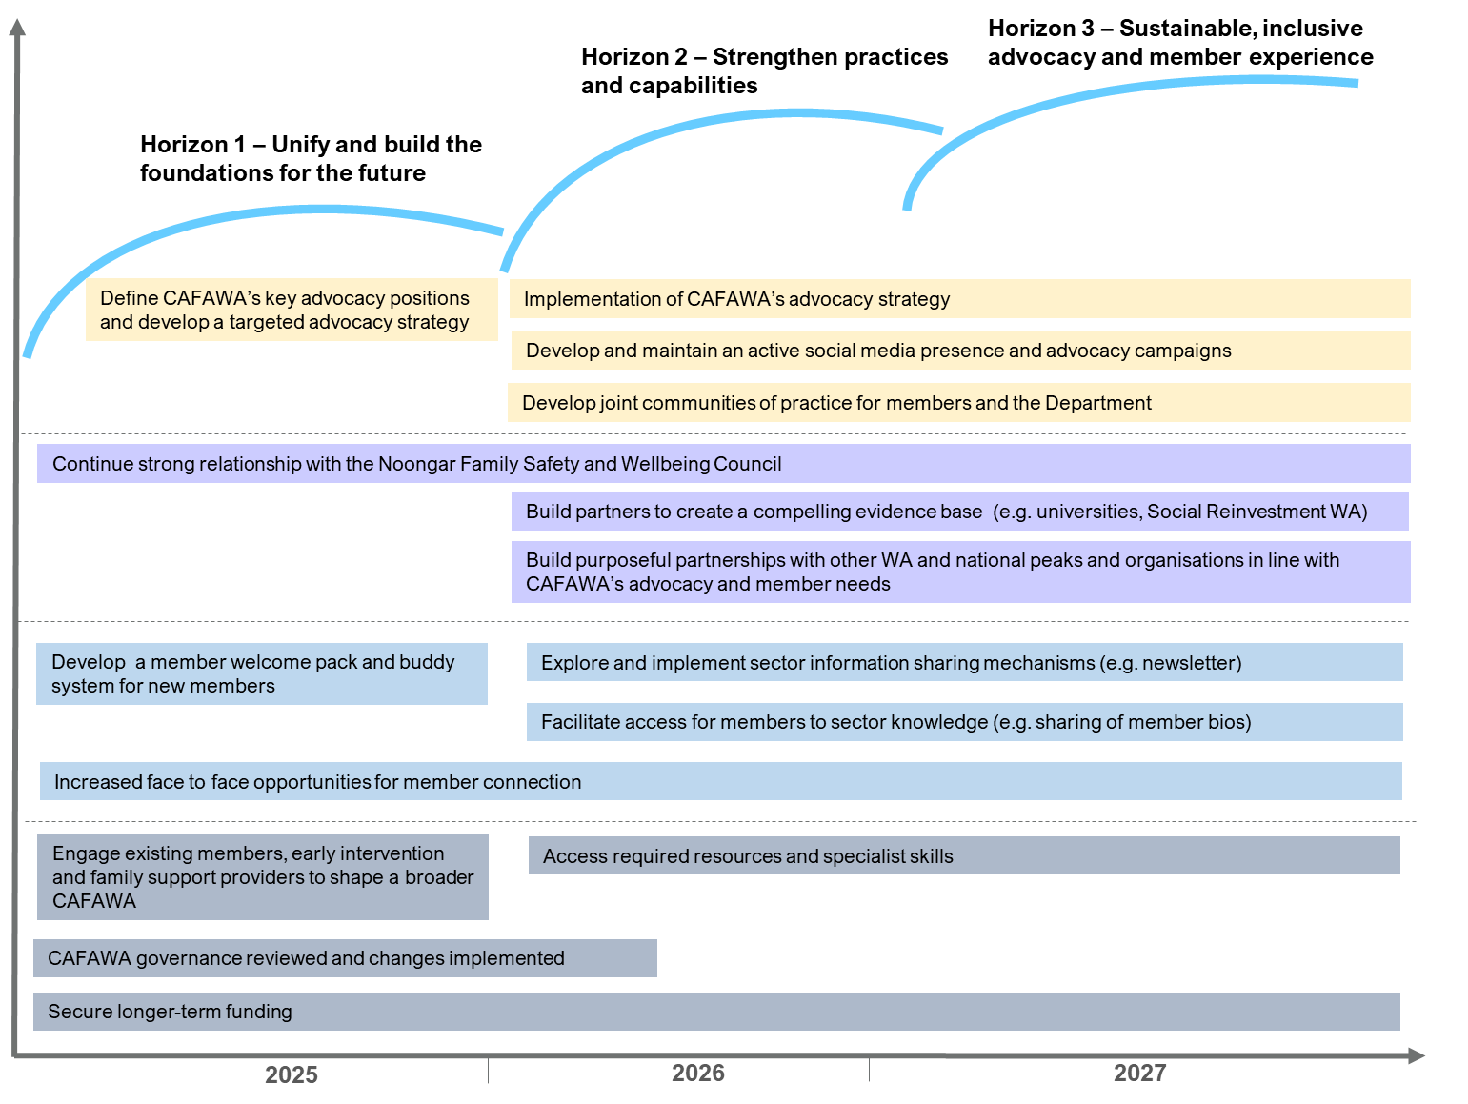
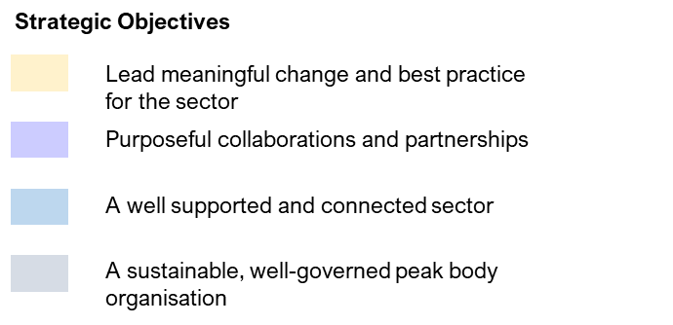
Key Initiatives 2025-2027

Slide 2
Horizon 3 – Sustainable, inclusive advocacy and member experience
Horizon 2 – Strengthen practices and capabilities
Horizon 1 – Unify and build the foundations for the future
Define CAFAWA’s key advocacy positions and develop a targeted advocacy strategy
Implementation of CAFAWA’s advocacy strategy
Develop and maintain an active social media presence and advocacy campaigns
Develop joint communities of practice for members and the Department
Continue strong relationship with the Noongar Family Safety and Wellbeing Council
Build partners to create a compelling evidence base (e.g. universities, Social Reinvestment WA)
Build purposeful partnerships with other WA and national peaks and organisations in line with CAFAWA’s advocacy and member needs
Develop a member welcome pack and buddy system for new members
Explore and implement sector information sharing mechanisms (e.g. newsletter)
Facilitate access for members to sector knowledge (e.g. sharing of member bios)
Increased face to face opportunities for member connection
Engage existing members, early intervention and family support providers to shape a broader CAFAWA
Access required resources and specialist skills
CAFAWA governance reviewed and changes implemented
Secure longer-term funding
2025
2026
2027

Slide 3
Strategic Objectives
Lead meaningful change and best practice for the sector
Purposeful collaborations and partnerships
A well supported and connected sector
A sustainable, well-governed peak body organisation

